Slide 1
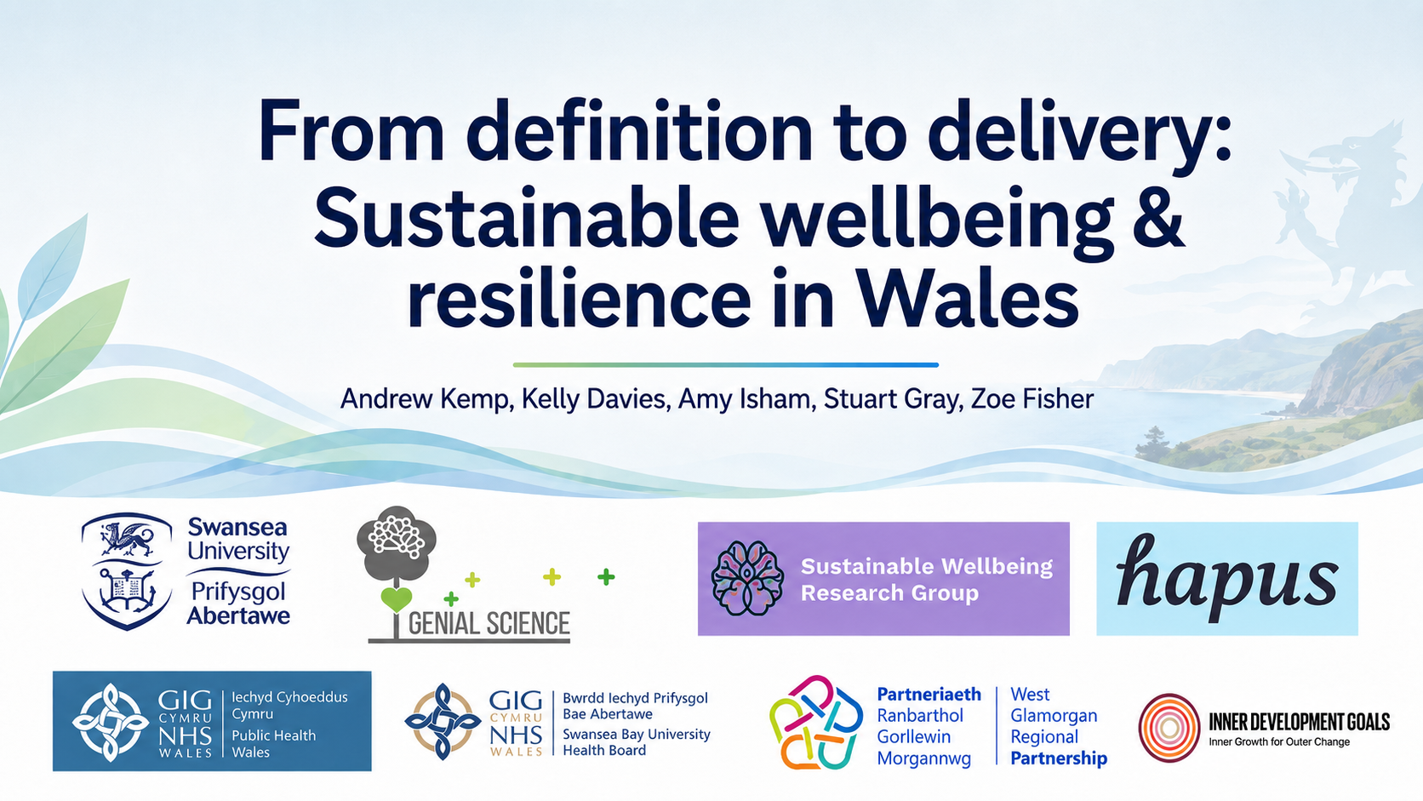

Slide 2
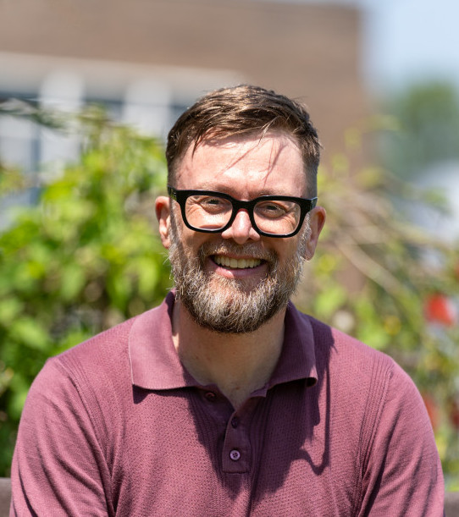

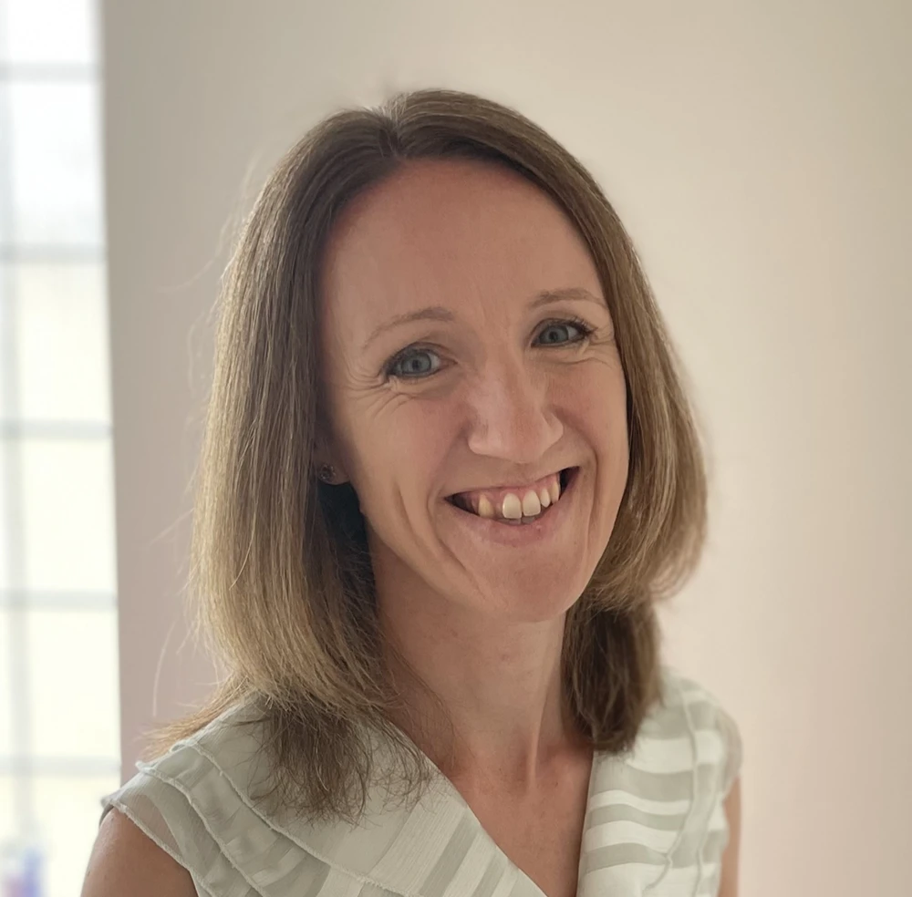

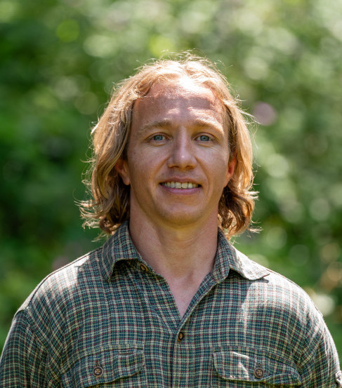
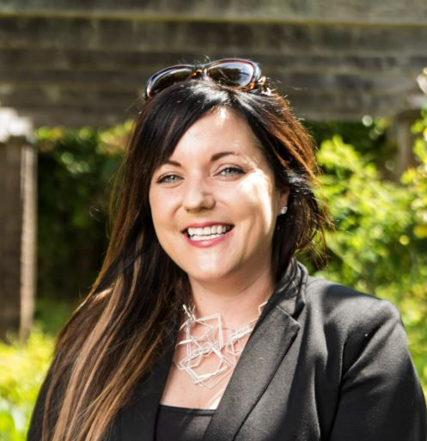

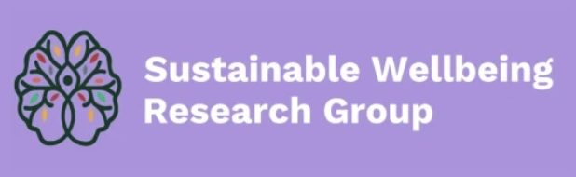
Introductions
(& Acknowledgements)
Andrew Kemp, speaker 1,
Professor of Psychology
Lowri Wilkie,
Postdoctoral researcher
Kelly Davies, speaker 2,
Coach & PhD candidate
Amy Isham, speaker 3,
Senior Lecturer in Psychology
Stuart Gray, speaker 4,
Student Wellbeing &
Peer Development Officer,
Student Life
Zoe Fisher, speaker 5,
Clinician & Associate Professor

Slide 3
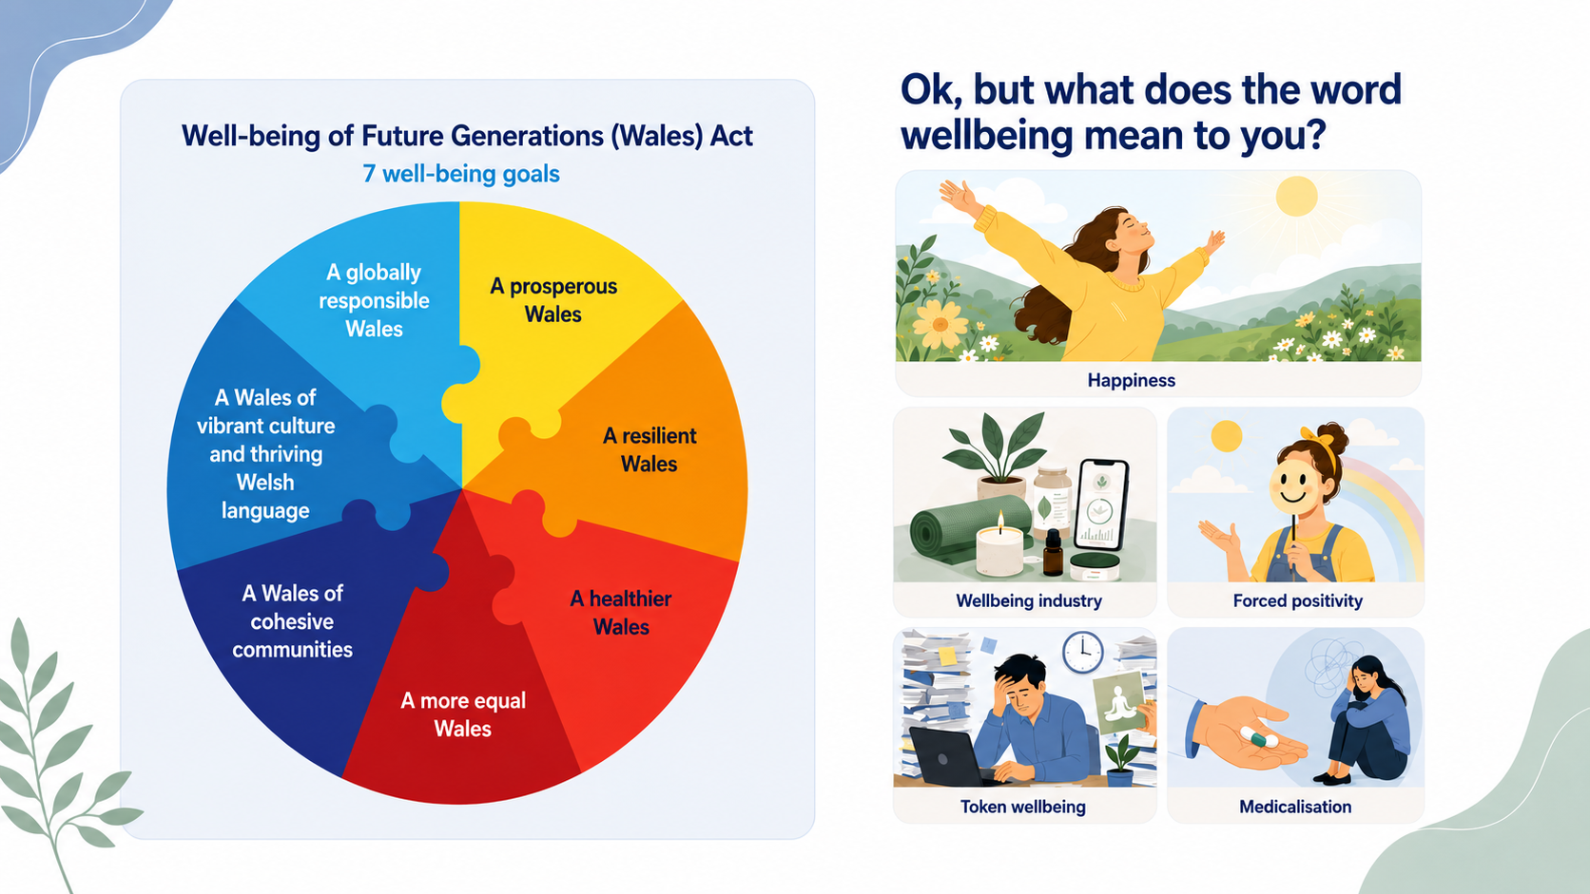

Slide 4
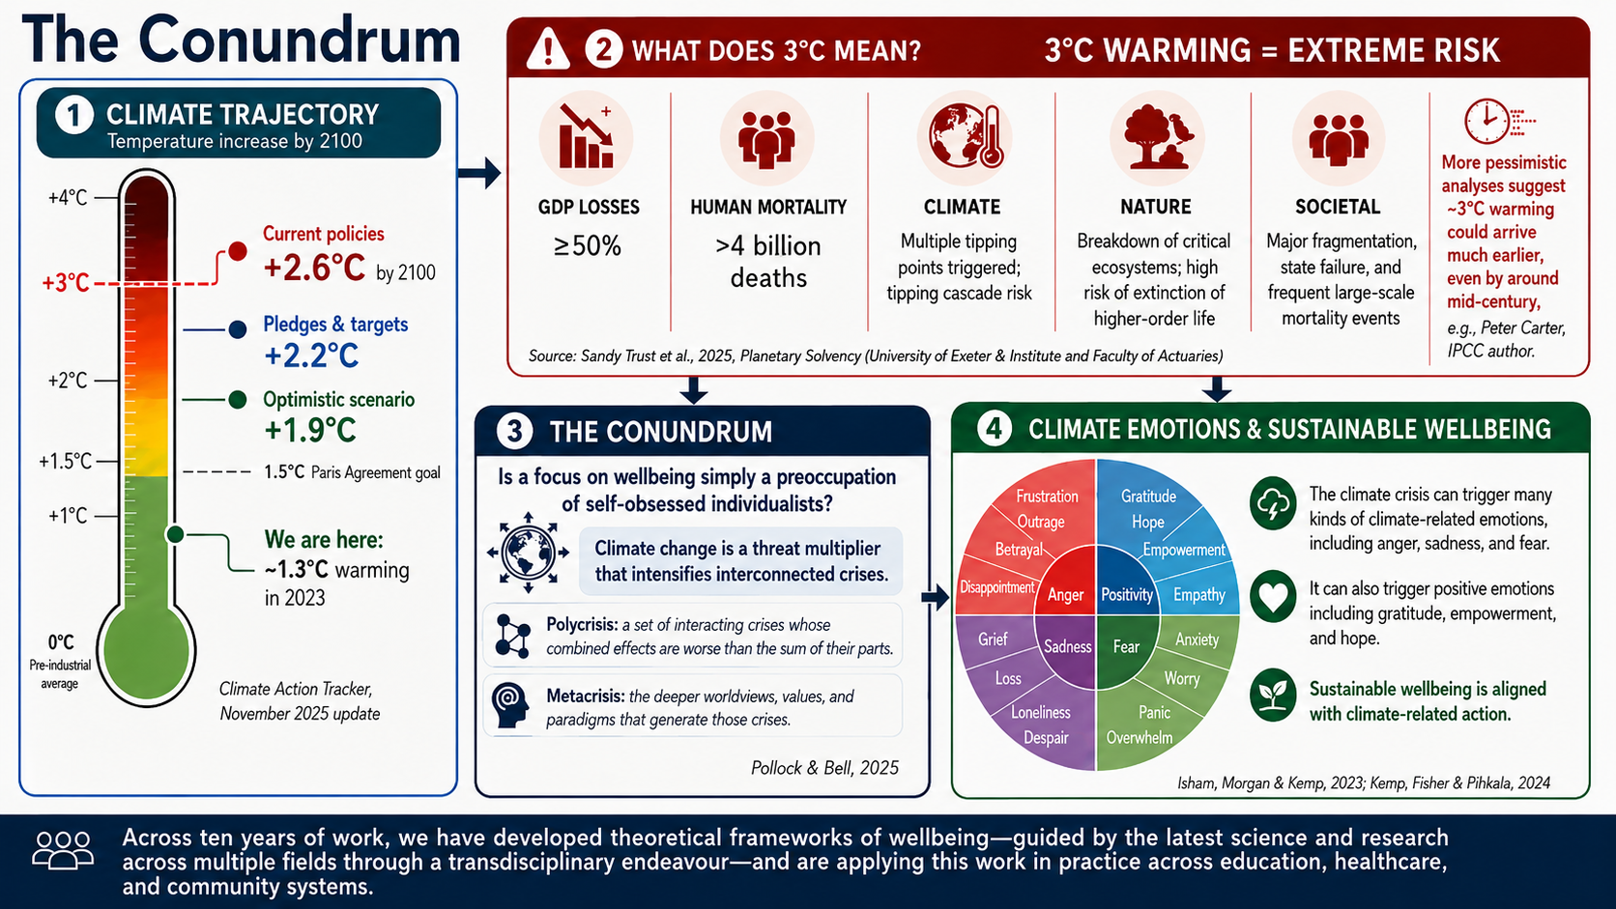
Notes:
Animals?

Slide 5
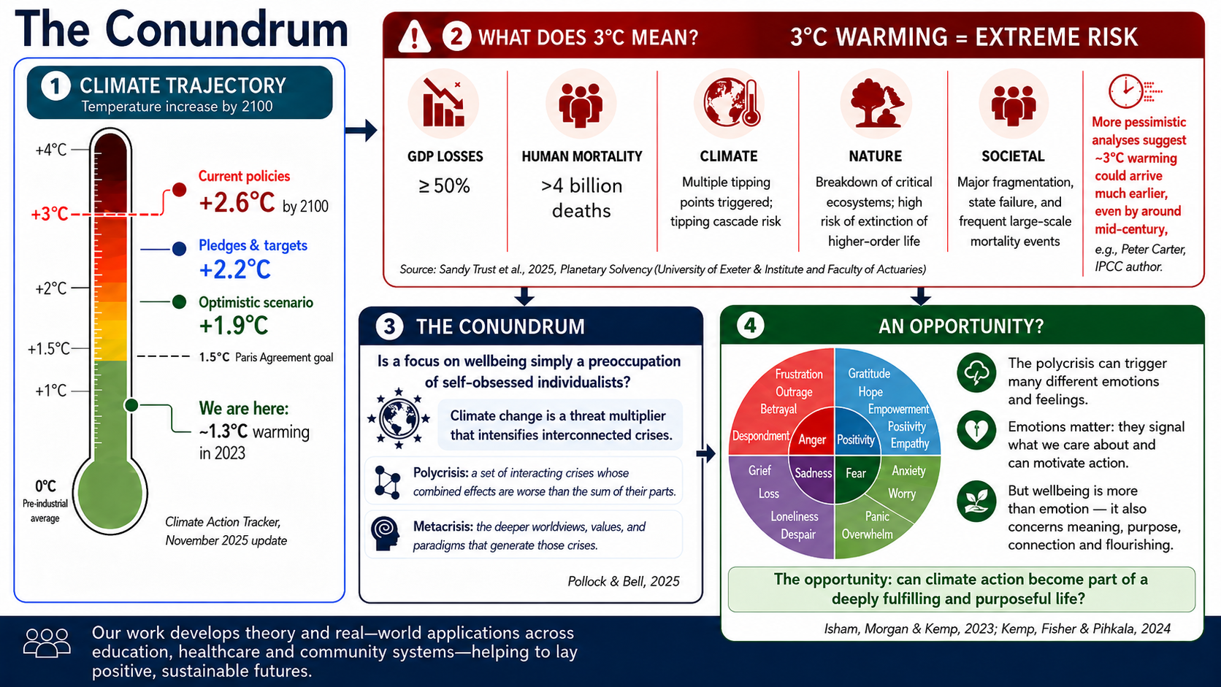

Slide 6
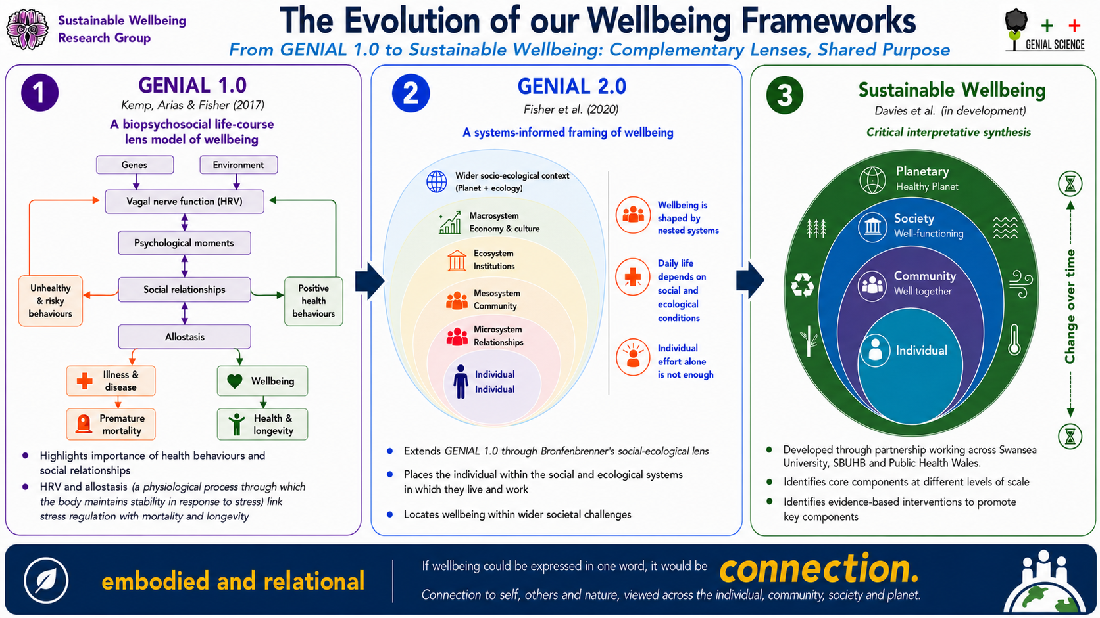

Slide 8
Introducing a Sustainable Wellbeing Framework
Kelly Davies, PhD Researcher
Notes:
I am now going to introduce a newly developed Sustainable Wellbeing Framework. I’ll begin with why we developed it, then a little about how we developed it, and finally the ways in which we are putting it to use in practice.

Slide 9




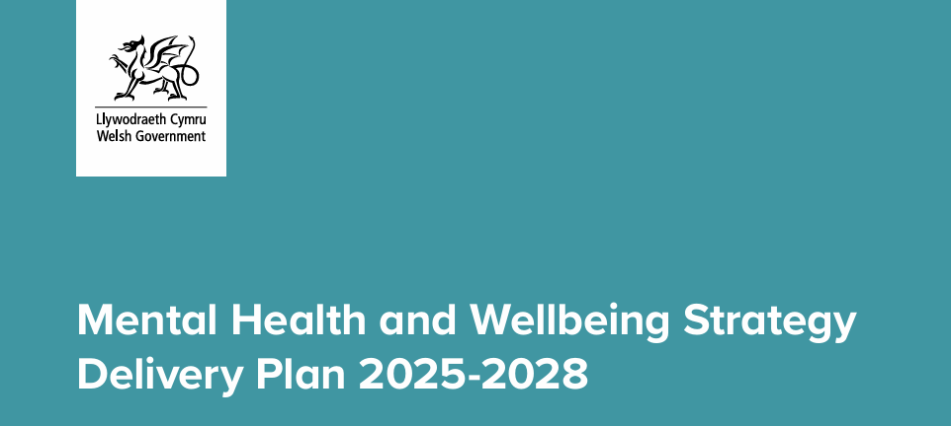
The beginning – a collaboration, different backgrounds, common goal
Universally applicable
Understandable language
Holistic
Aim: a shared, practical understanding of lasting wellbeing to communicate and support action with individuals and communities.
"Everyone has the knowledge, opportunities, and confidence to protect and promote good mental health and wellbeing."
Sufficiently specific and detailed to be able to identify practical action.
Notes:
To start at the beginning, this framework emerged from a collaboration between people working across different academic and professional contexts, including public health, regional partnership, clinical practice and academia. Although we came from different backgrounds, we shared a common aim: to develop a practical understanding of lasting wellbeing that could be communicated clearly and used to support action with individuals and communities.
For the framework to be useful across different populations and contexts, it needed to meet several criteria. It needed to be as universally applicable as possible, use language that people could understand, and be holistic: recognising both the individual factors that shape wellbeing and the wider contextual factors that influence people’s opportunities to build wellbeing. It also needed to be sufficiently specific. We wanted people to be able to look at the framework, identify the different components, and then consider practical actions that might support each one.
Part-way through its development, the Welsh Government Mental Health and Wellbeing Strategy delivery plan was published. One of its aims is that everyone has the knowledge, opportunities and confidence to protect and promote good mental health and wellbeing. That fitted closely with what we were trying to achieve through this framework.

Slide 10
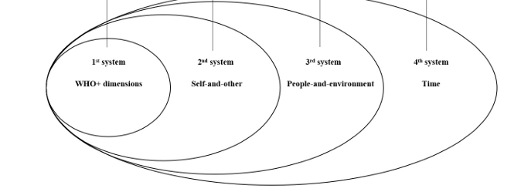
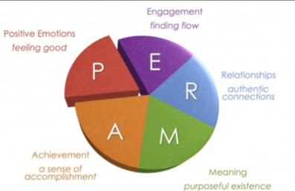
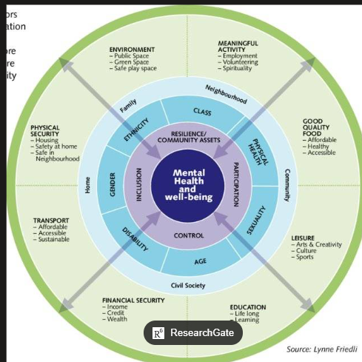
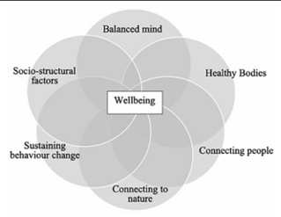
Why another model?
Sustainable Wellbeing
Individual Wellbeing Models (Psychology)
  PERMA
  Self-determination theory
Wider determinant focused models (Public Health)
  Marmot Principles
  Mental Wellbeing Impact assessment
GENIAL (Kemp, Arias & Fisher, 2017; Kemp & Fisher, 2022; Mead, Fisher & Kemp, 2021); sustainable wellbeing (Lomas, Pawelski & VanderWeele, 2024); PERMA (Seligman, 2011); self-determination theory (Ryan & Deci, 2000); wider determinants/MWIA (Marmot, 2010, 2020; Friedli et al., 2011).
GENIAL
Notes:
The first question is: why develop another model? When we looked across the existing wellbeing literature, including models developed by colleagues involved in this work, we found that the literature tended to fall into three broad groups.
The first group was individual wellbeing models, such as PERMA and self-determination theory. These are useful because they give detail about the components of individual wellbeing and can help identify practices that support those components.
The second group was wider determinant or public health models, such as the Marmot principles and Mental Wellbeing Impact Assessment. These are strong in explaining the wider contextual factors that shape wellbeing, but they are less detailed in relation to individual wellbeing components.
The third group was integrated models, such as GENIAL and sustainable wellbeing. These bring individual and contextual factors together, but they do not always provide the level of component detail we needed for practical application. So, while each model was useful, none fully met the aims we had set for this particular framework.

Slide 11

Filling the gap
"All models are wrong, but some are useful” (Box, 1976)
Critical Interpretive Synthesis - create overarching theory from integrating existing research
Notes:
Importantly, we were not trying to reinvent the wheel. There is already a substantial body of wellbeing research, spanning different academic and practice-based traditions. We were guided by George Box’s phrase that ‘all models are wrong, but some are useful’. For us, the aim was not to develop a perfect model of wellbeing, but a useful one: a framework designed for communication, reflection and practical application.
We therefore used an approach called Critical Interpretive Synthesis. At its heart, this is a review method that aims to build overarching theory by integrating and interpreting existing research.

Slide 12
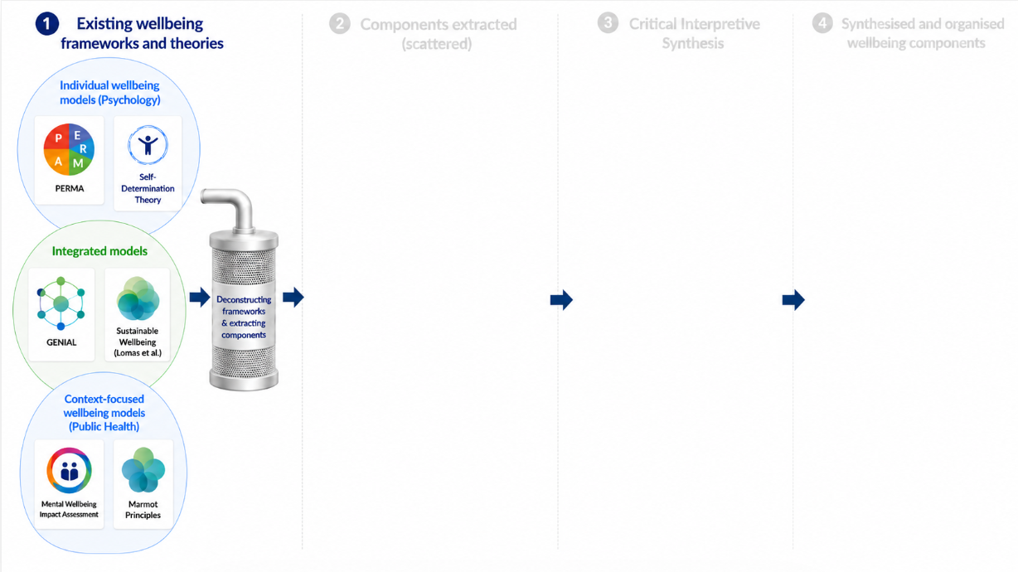
Notes:
To explain briefly how we did this: we began by bringing together more than 40 wellbeing frameworks and theories.
These included individual wellbeing models, integrated models and context-focused models. We then deconstructed these frameworks, looking across them to identify the different wellbeing components and wider determinants they contained. We extracted those concepts, looked at how they were defined, and created a large pool of candidate components.

Slide 13
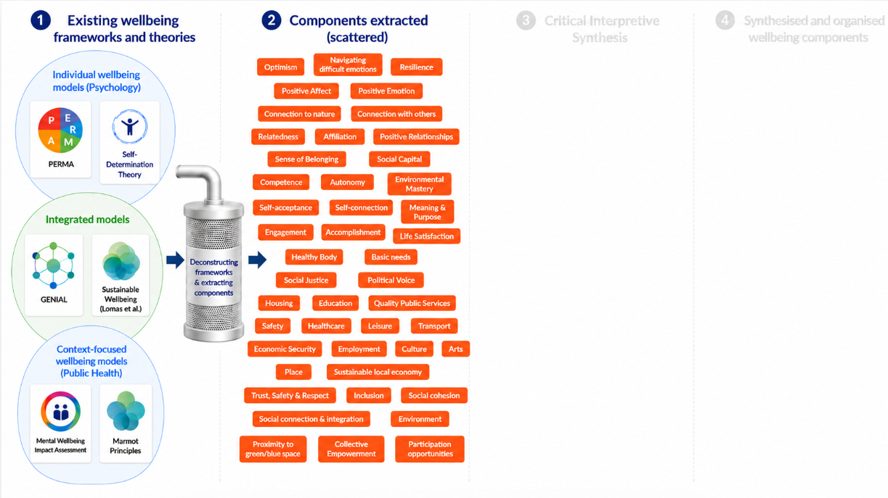
Notes:
This left us with a large set of extracted concepts. Some were clearly individual wellbeing components, some were wider contextual influences, and some overlapped with one another or used different language for similar ideas.

Slide 14
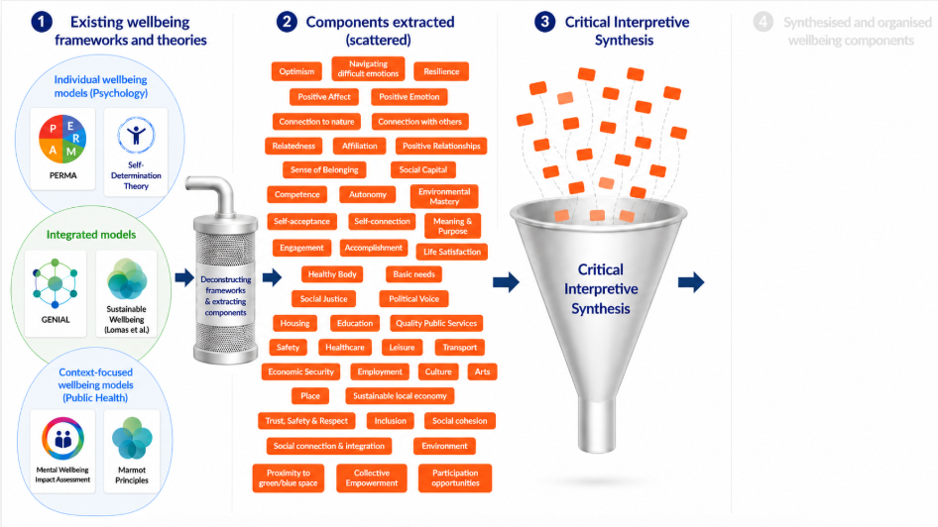
Notes:
We then moved into the interpretive synthesis. I tend to think of this as a filtering process. We compared and contrasted the extracted concepts, brought similar ones together, and considered whether some should be removed.
The decisions were guided by the aims we had set at the beginning. We wanted the framework to be broadly applicable across populations and contexts, holistic enough to include individual and contextual factors, and practical enough to support action. These aims became our lines of argument: the principles we used to decide which concepts should be retained, combined or excluded.

Slide 15
The beginning – a collaboration, different backgrounds, common goal
Universally applicable
Understandable language
Holistic
Aim: a shared, practical understanding of lasting wellbeing to communicate and support action with individuals and communities.
"Everyone has the knowledge, opportunities, and confidence to protect and promote good mental health and wellbeing."
Sufficiently specific and detailed to be able to identify practical action.
Notes:
Universal
Practical

Slide 16
Universal
Practical
Not a measure, consequence or facilitator
Notes:
We also used exclusion principles to keep the framework clear and usable. We tried not to include concepts that were better understood as measures of wellbeing, consequences of other components, or facilitators of wellbeing rather than components in their own right.

Slide 17
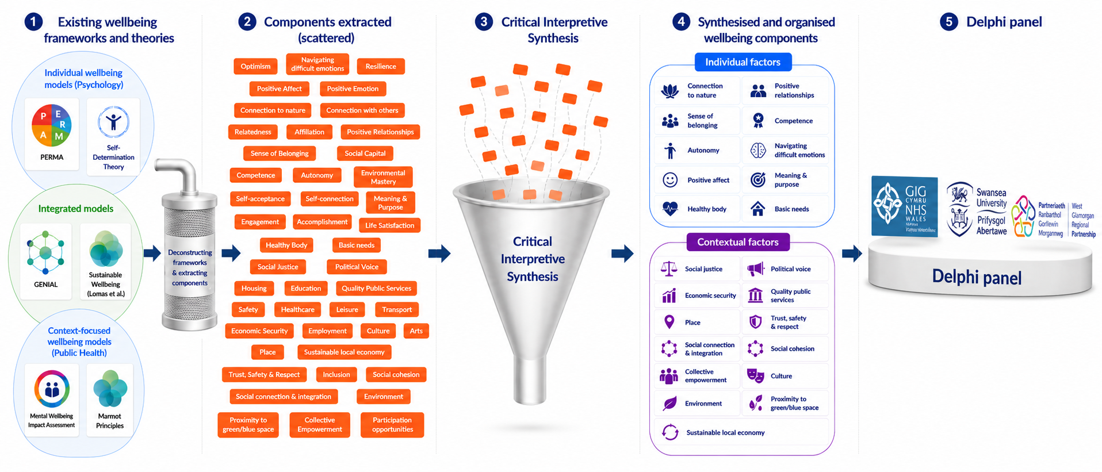
Notes:
Once we had an initial set of individual and contextual factors, we took these to a Delphi-style expert panel. This included colleagues from the organisations I mentioned at the start. Together, we reviewed the proposed components, challenged the decisions, refined the definitions, and considered how the framework should be organised and communicated.
The Delphi-style panel was important because it brought together different disciplinary and practice-based perspectives. The panel helped test whether the emerging framework was not only grounded in the literature, but also understandable and useful for real-world application.

Slide 18
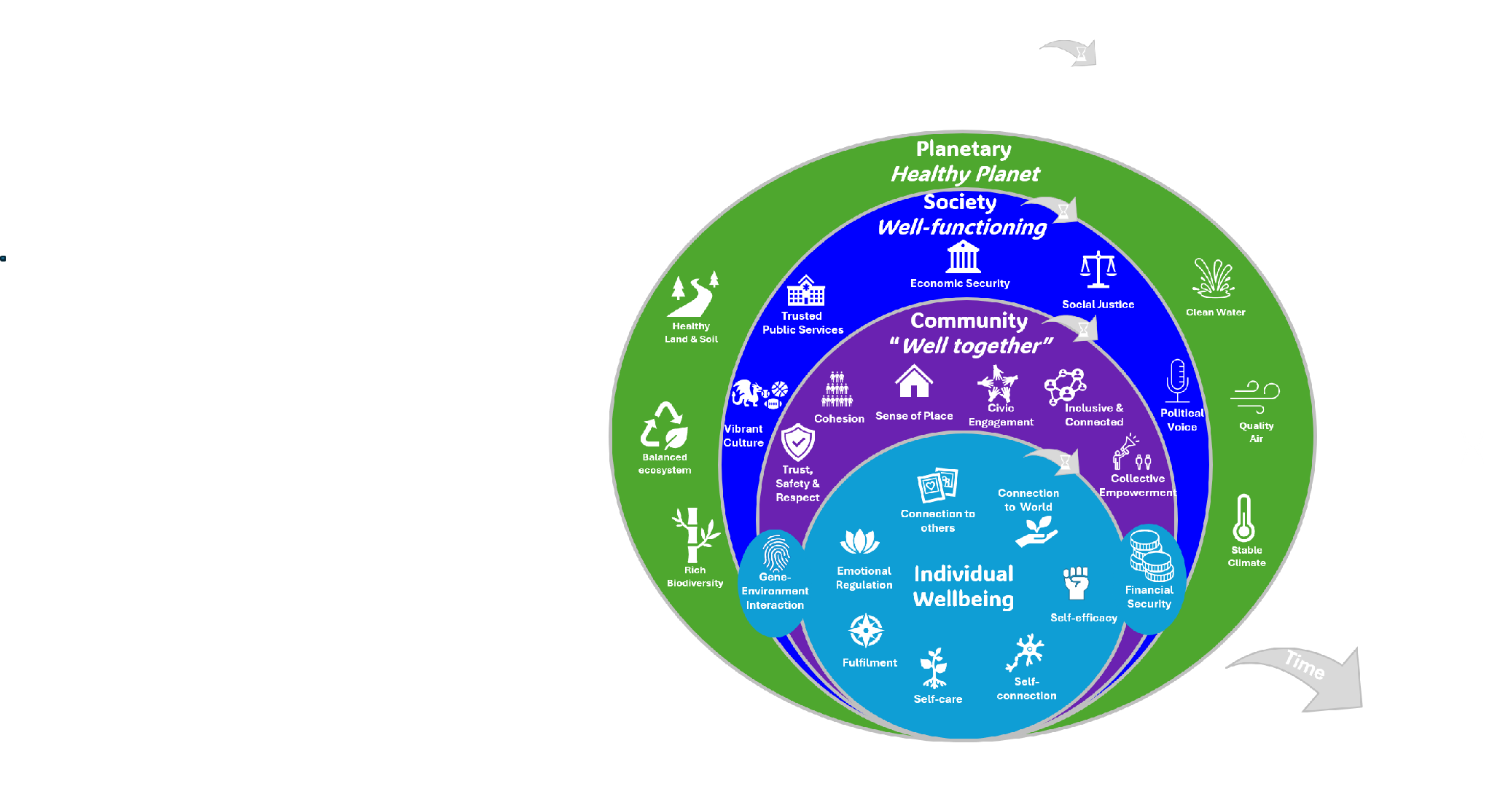

Notes:
The framework that emerged is shown on the slide. At the centre are the individual components of wellbeing. As we analysed the wider determinants, it became clear that many of them were not simply external influences on individuals; they also reflected the wellbeing of the systems around us.
We therefore organised the wider determinants into three further layers. The first is community: what helps us to be well together. The second is society: what makes a society well-functioning. The third is the planet: the conditions needed for a healthy planet.
This layered structure shows that individual wellbeing is shaped by the community, society and planet around us. Community wellbeing is not just the sum of individual wellbeing. It also includes the conditions that allow people to connect, support one another, feel safe, take part and work together. Communities are then shaped by the wider society around them: policies, infrastructure, inequality, public services, and whether people have a voice in decisions that affect them. All of these layers depend on a healthy planet.
Time is also important. At the individual level, we are interested in lasting wellbeing across a person’s life. At the community level, wellbeing is sustained through welcoming new members and sharing knowledge across generations. At the societal level, this links with the Well-being of Future Generations Act in Wales. And at the planetary level, sustainability is essential for people living today and for future generations.

Slide 19
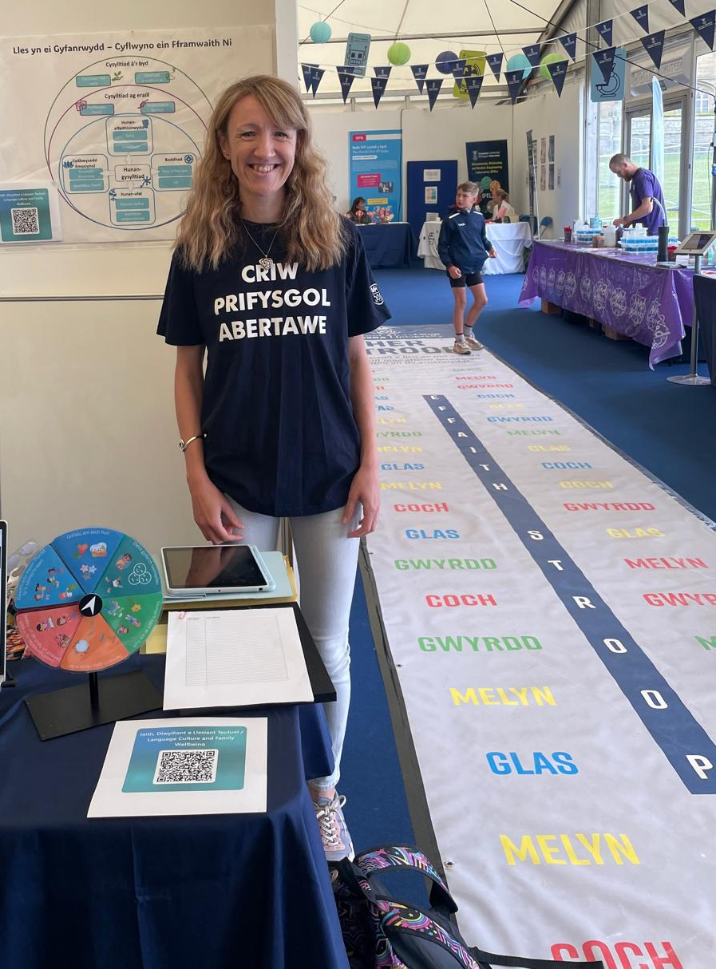
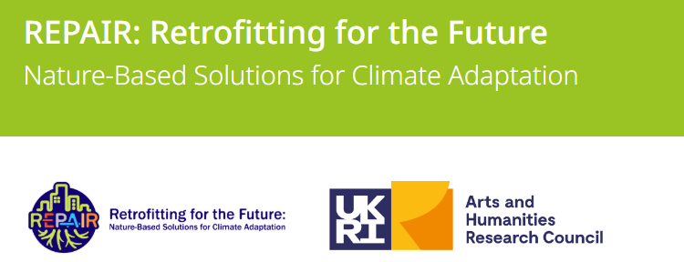
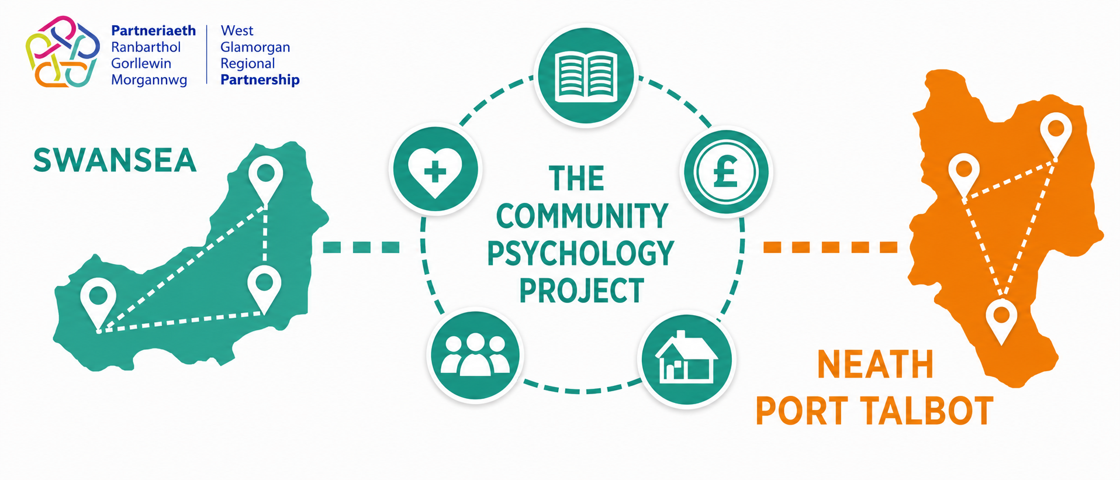
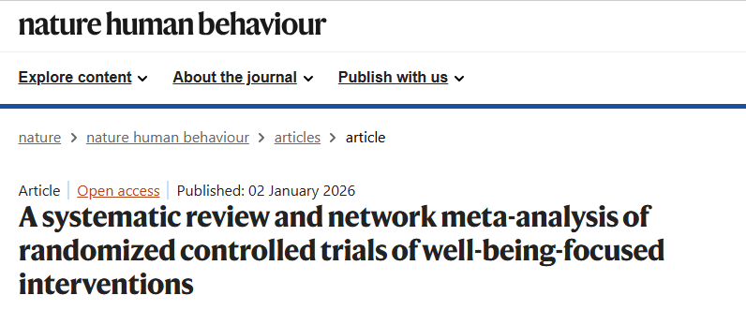
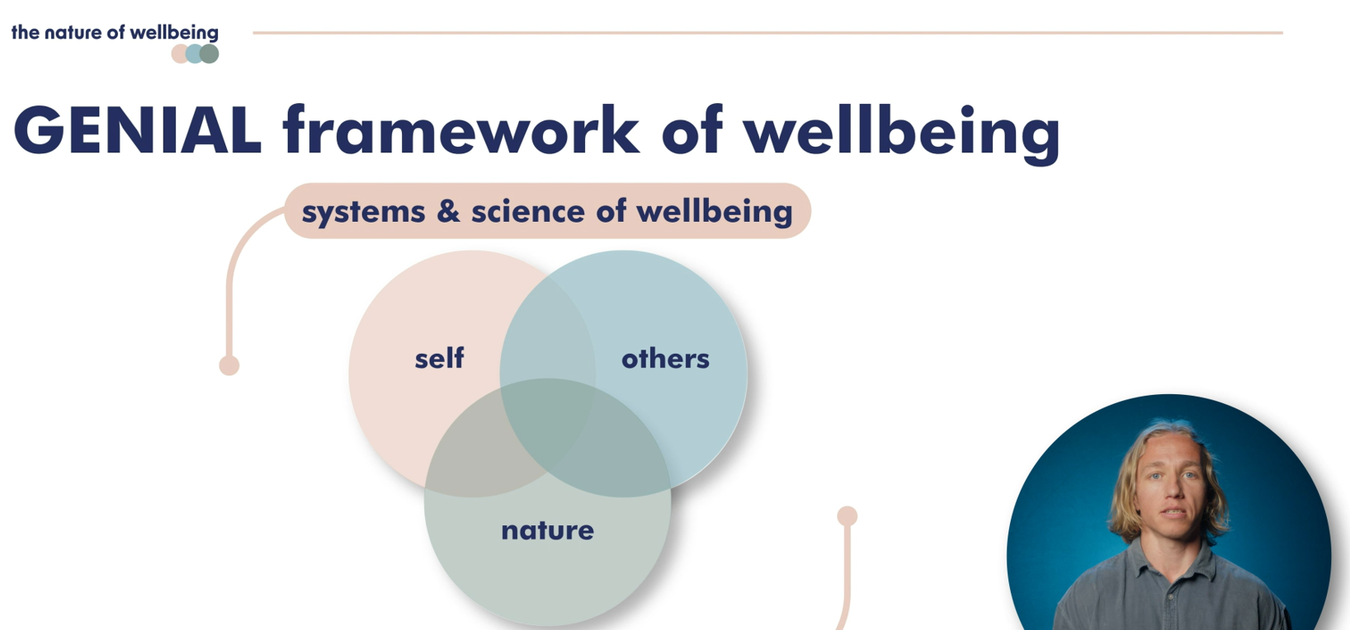


Examples of application in practice
Welsh Language & Culture & Wellbeing
Notes:
So how are we using the framework in practice? In this symposium, you will hear several examples that speak to different layers of the model. Professor Andrew Kemp has just spoken about the REPAIR project, which focuses on nature-based solutions and links planetary wellbeing with community wellbeing.
[]I presented work on Welsh language, culture and wellbeing, which sits particularly within the cultural and societal layer of the framework. As part of my PhD, I am also evaluating a community psychology project in West Glamorgan, which focuses on building wellbeing at the community level.
In the rest of this session, Dr Lowri Wilkie will talk about network meta-analysis of wellbeing interventions, focused on building individual wellbeing. Stuart Gray, the Student Mental Health Lead at Swansea University, will talk about building wellbeing for individuals within the student community and strengthening student community wellbeing. Finally, Dr Zoe Fisher, together with Sue, will talk about scaling evidence-based wellbeing interventions across student populations and people with acquired brain injury.

Slide 20
What’s next?
Lived experience research with under-researched groups.
Does it resonate?
Is it understandable?
Is it useful?
Notes:
So what comes next? In a few moment, Amy Isham will talk about her research work obtaining themes about what wellbeing means across the general population. In order to test the understandability and resonance of this framework I will be taking the framework into lived experience research with under-researched groups. This brings us back to the original aims of the framework. We want to know whether it resonates with people, whether the language is understandable, and whether people find it useful as a way of reflecting on their own wellbeing and identifying practical ways to build it.
I am also exploring its use in a coaching context: looking at whether the framework can support coaching conversations about wellbeing, goal-setting and practical strategies for building lasting wellbeing.
Thank you.

Slide 21
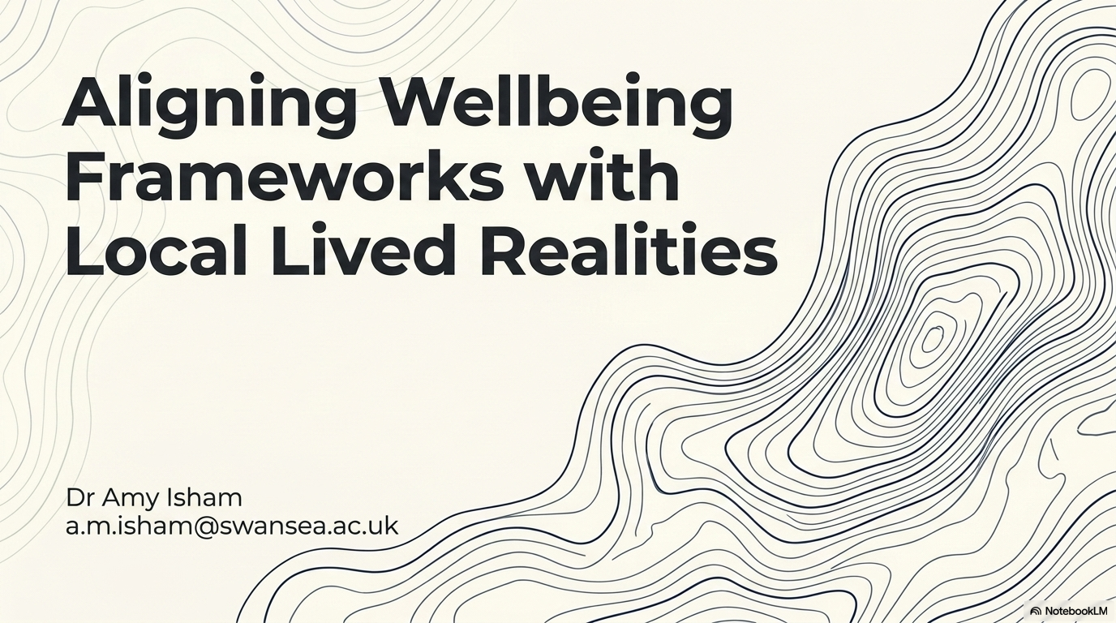


Slide 22
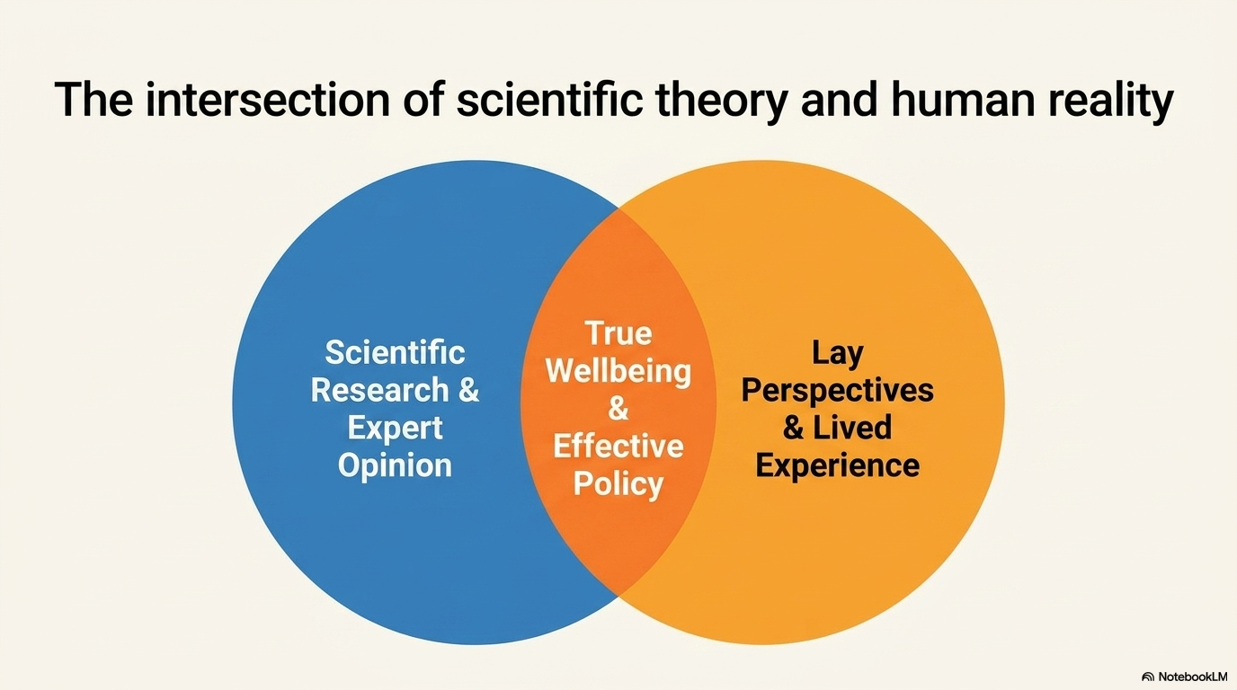

Slide 23
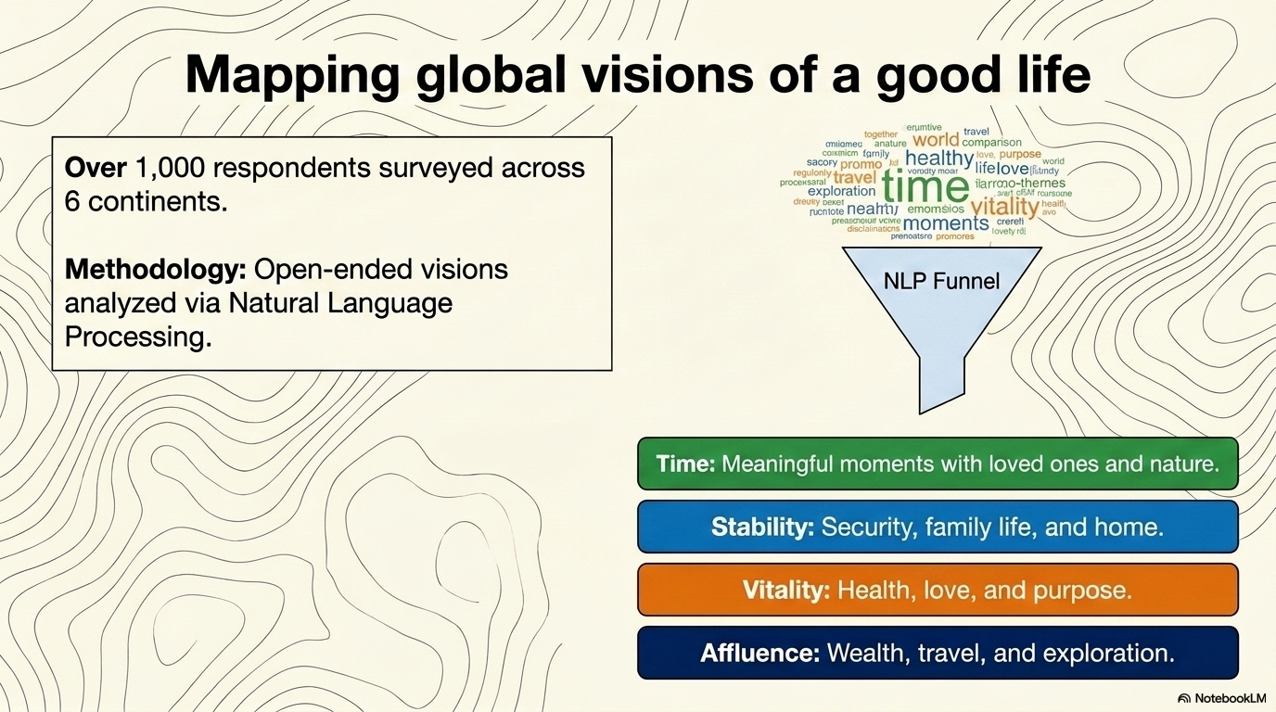

Slide 24
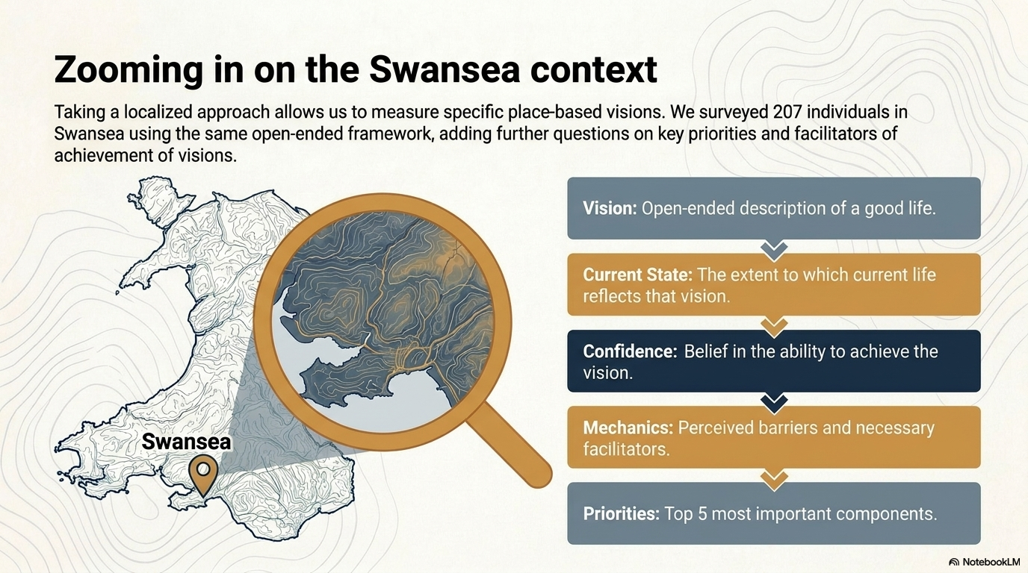

Slide 25
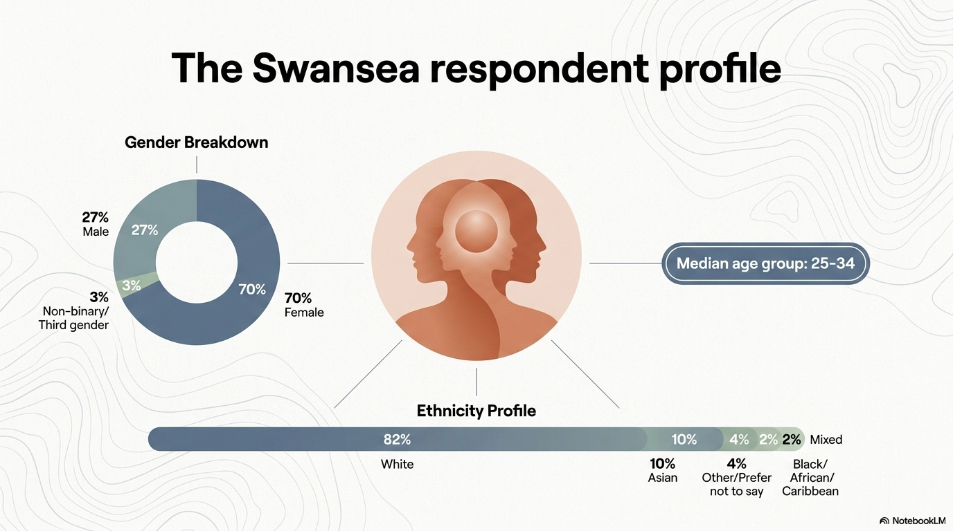

Slide 26
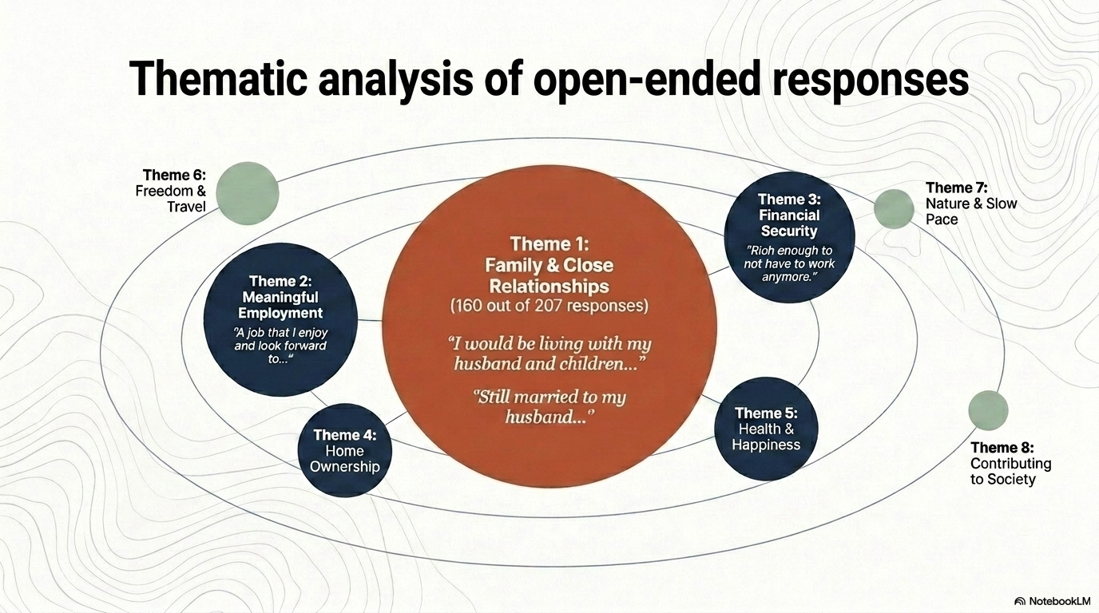

Slide 27
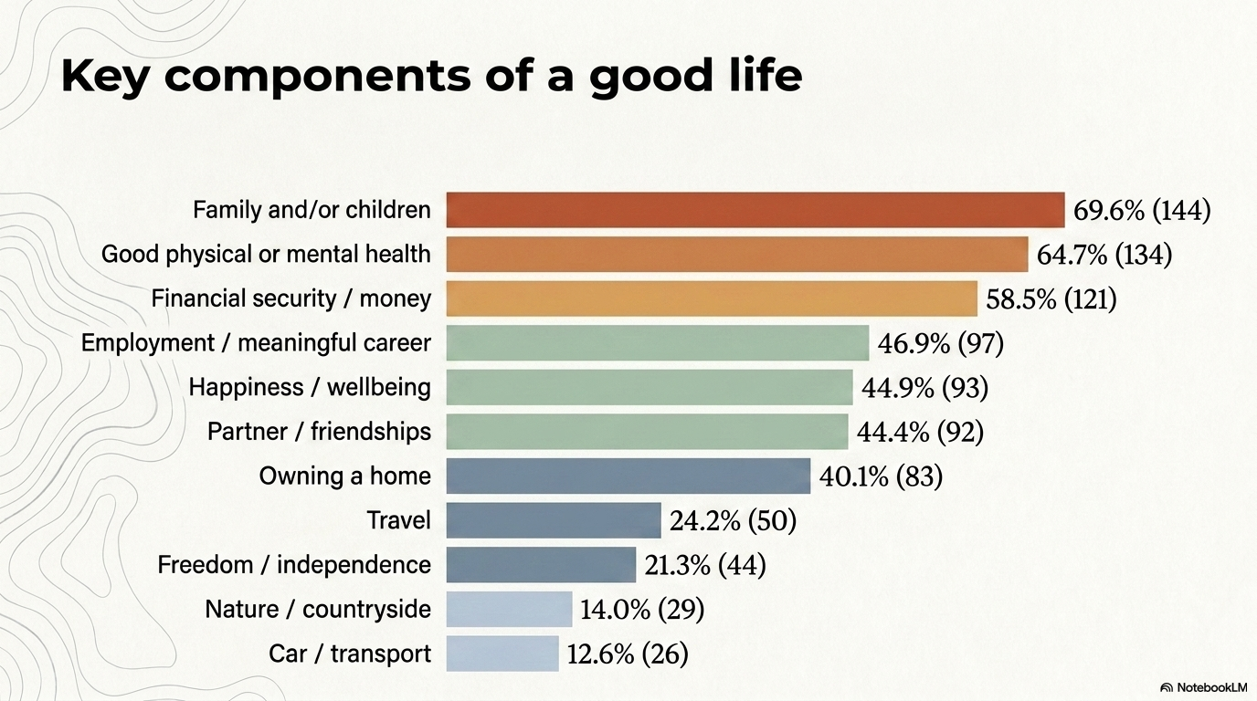

Slide 28
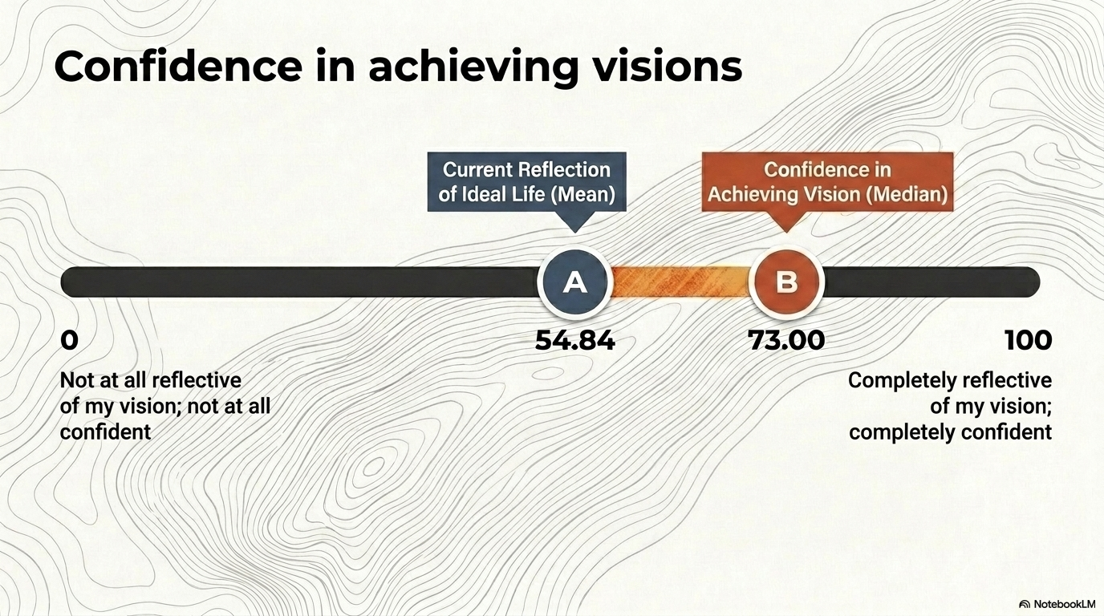

Slide 29
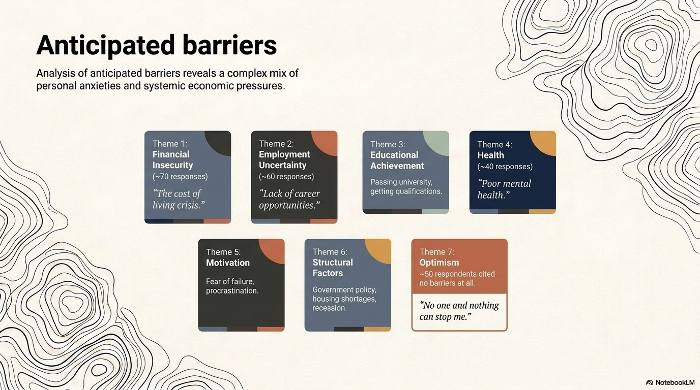

Slide 30


Travel
(component)
Home ownership
(component)
Secure employment
(component and barrier)
Educational achievement
(barrier)
Contributing to society
(component)
Family and close relationships
(component)
Health
(component and barrier)
Financial security
(component and barrier)
Nature
(component)
Motivation
(barrier)

Slide 31
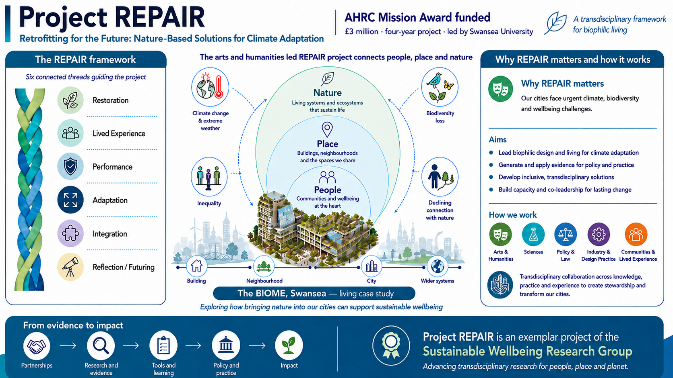
REPAIR – exemplar project

Slide 32
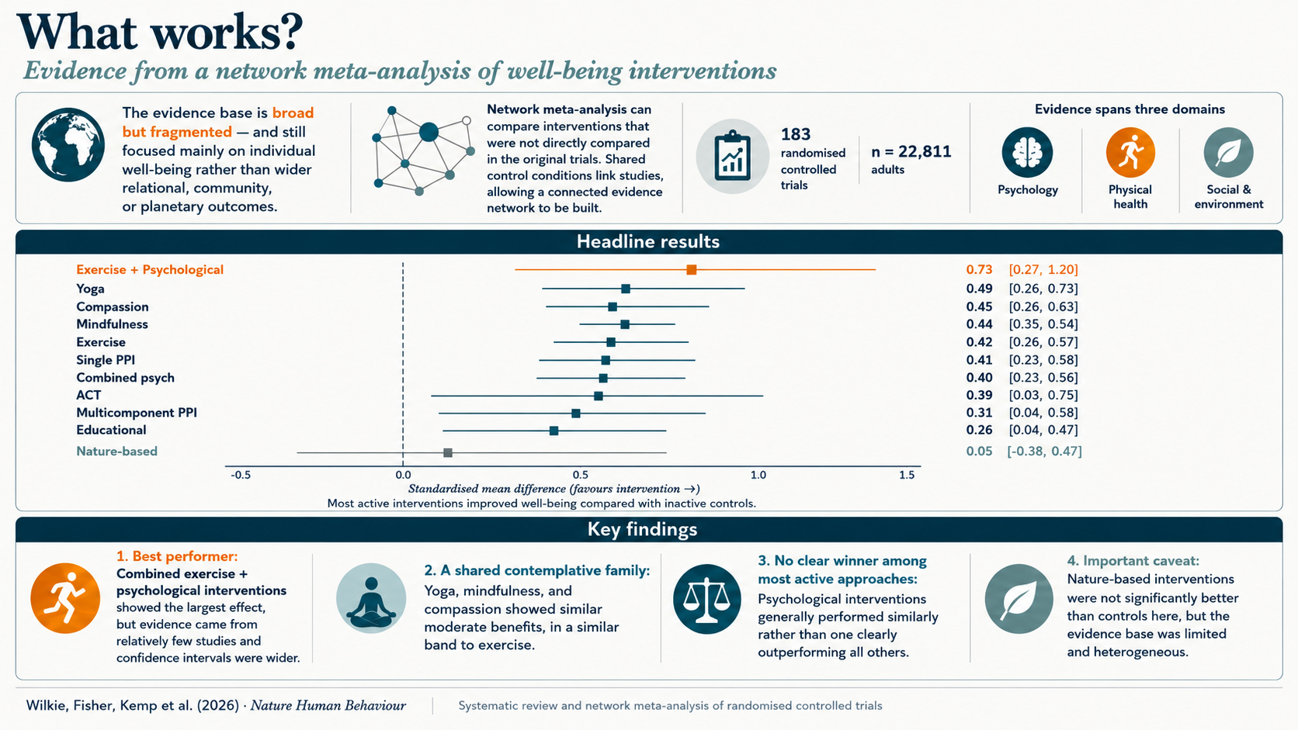

Slide 34
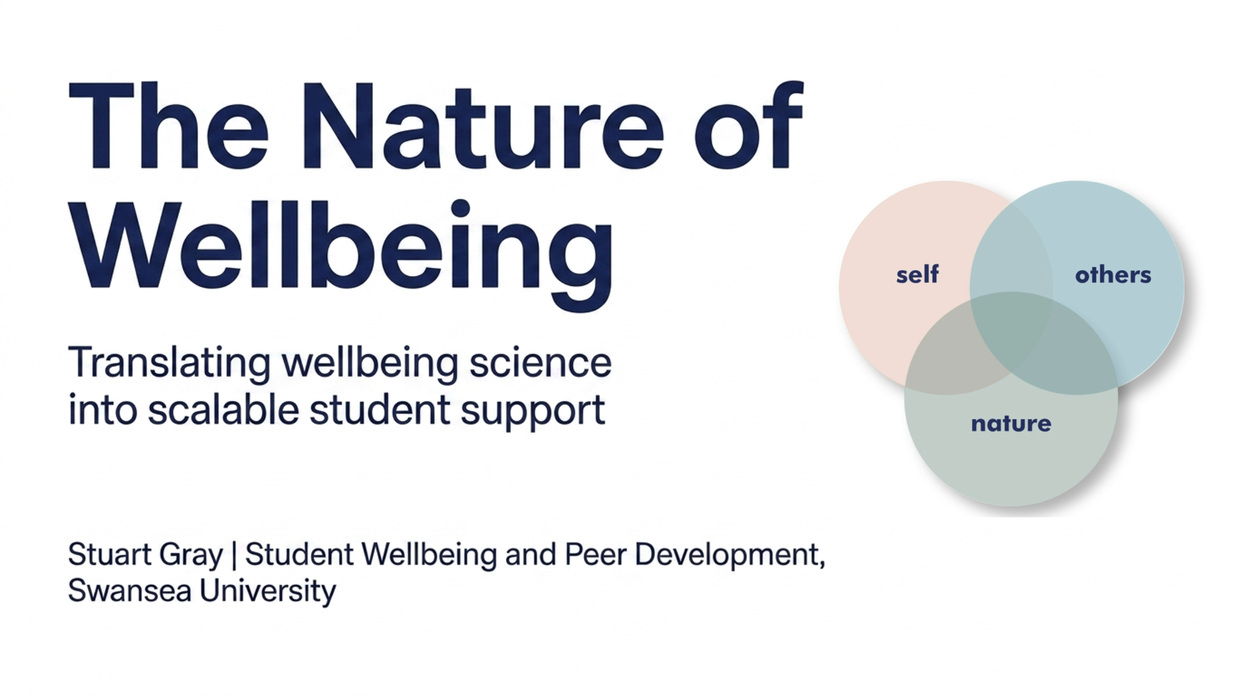

Slide 35
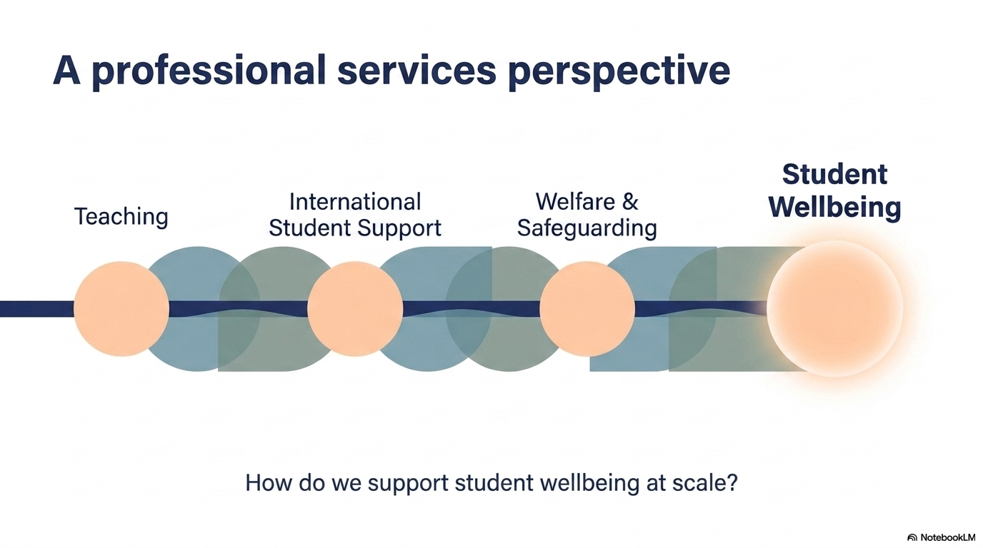

Slide 36
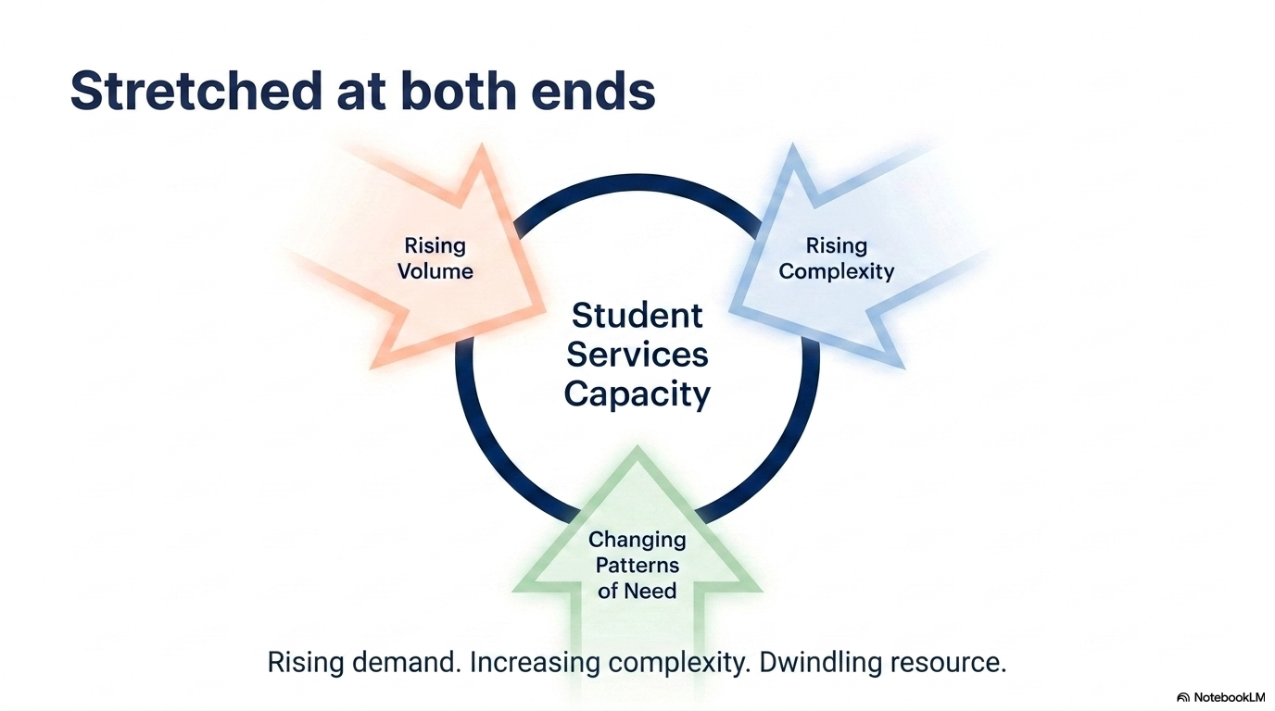
McGorry et al., 2024; Hughes et al., 2024; Campbell et al., 2022

Slide 37
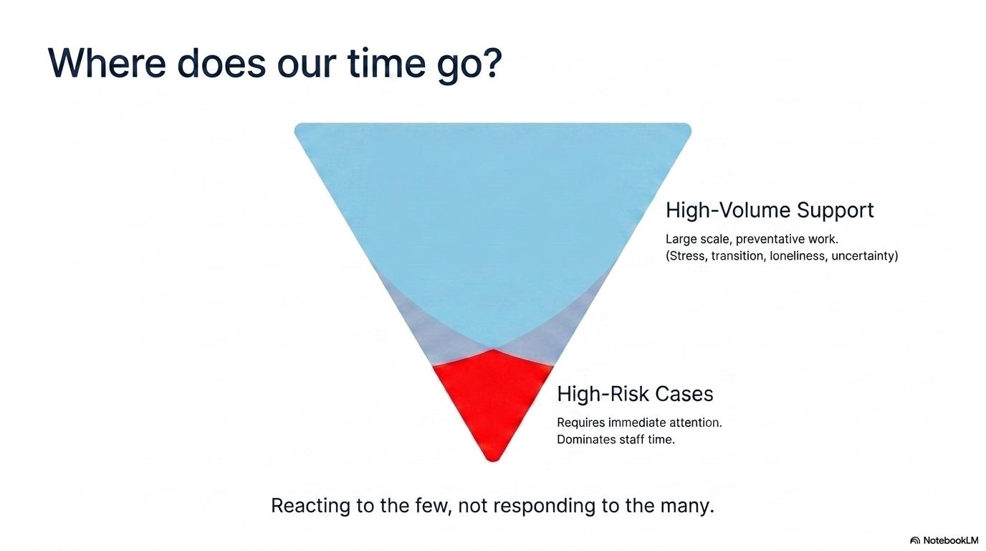

Slide 38
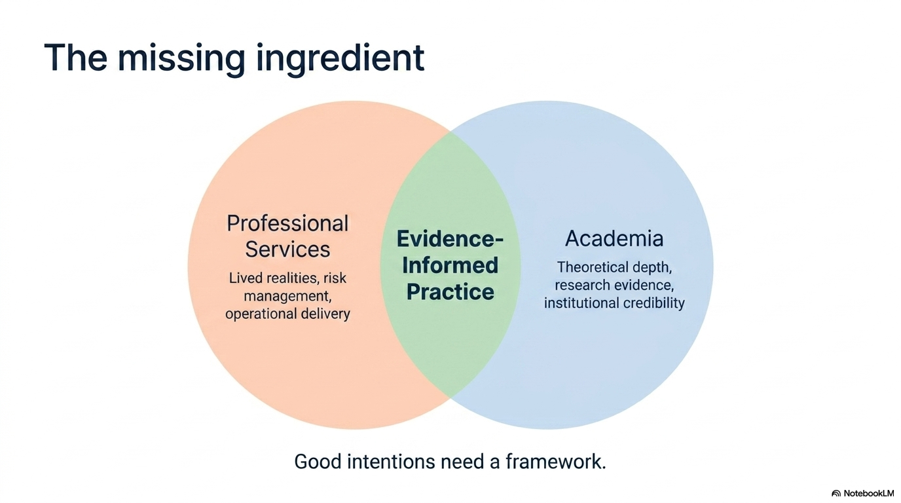

Slide 39
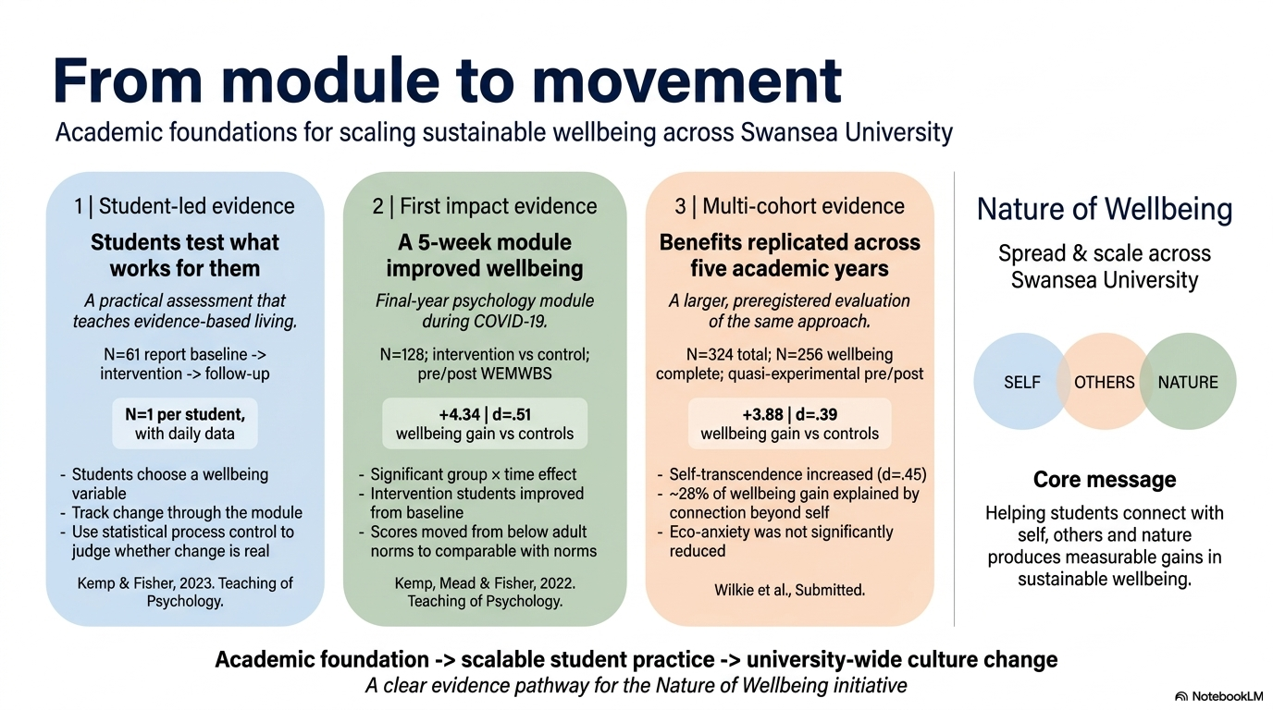

Slide 40
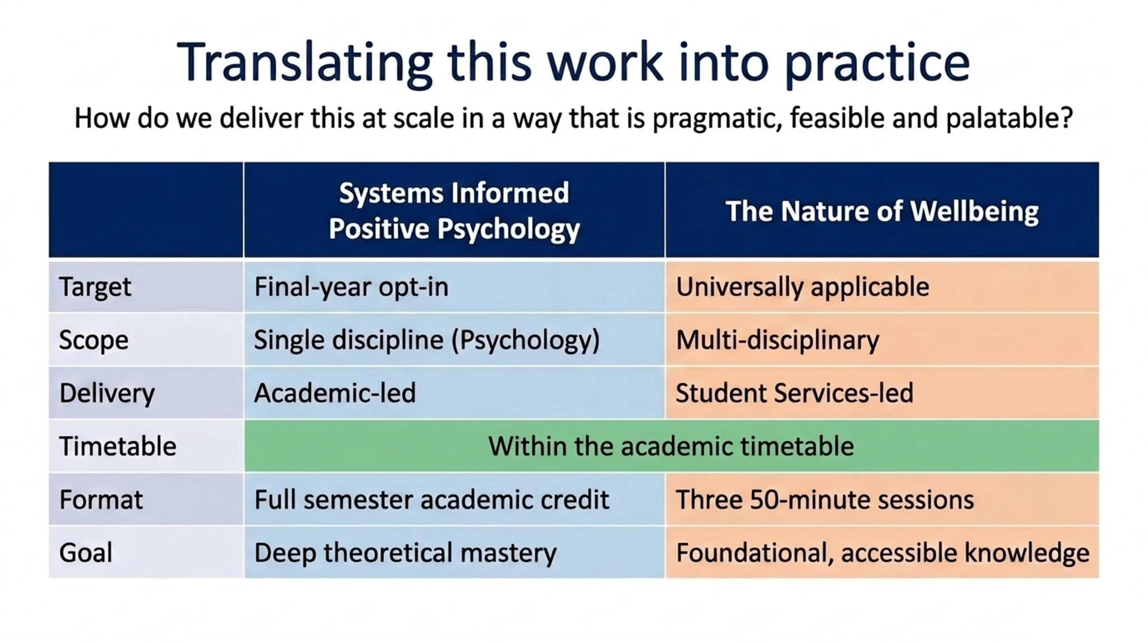

Slide 41
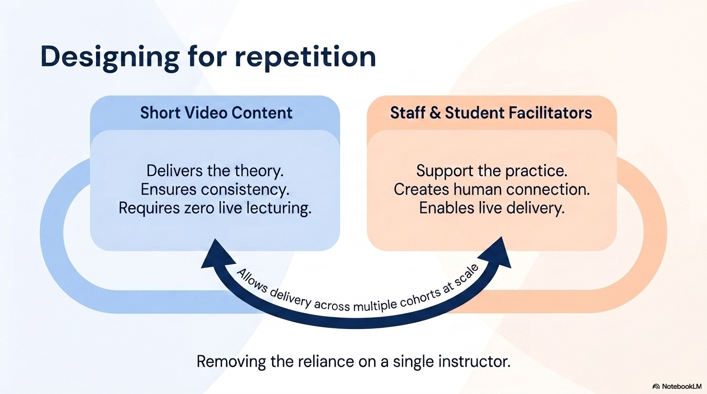

Slide 42
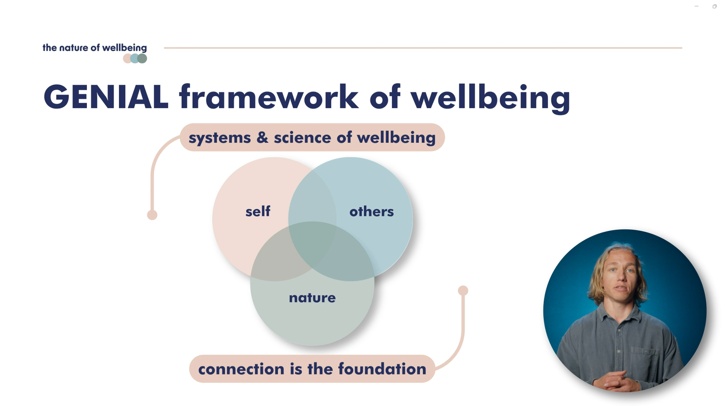

Slide 43
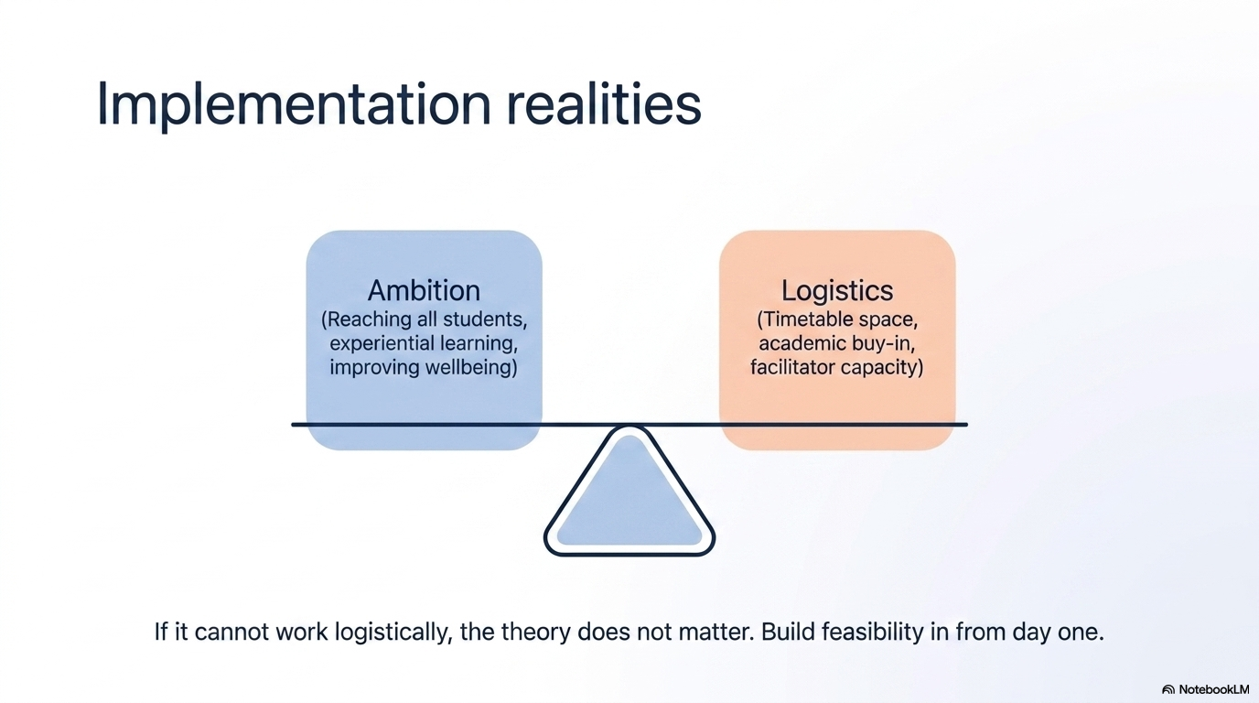

Slide 44
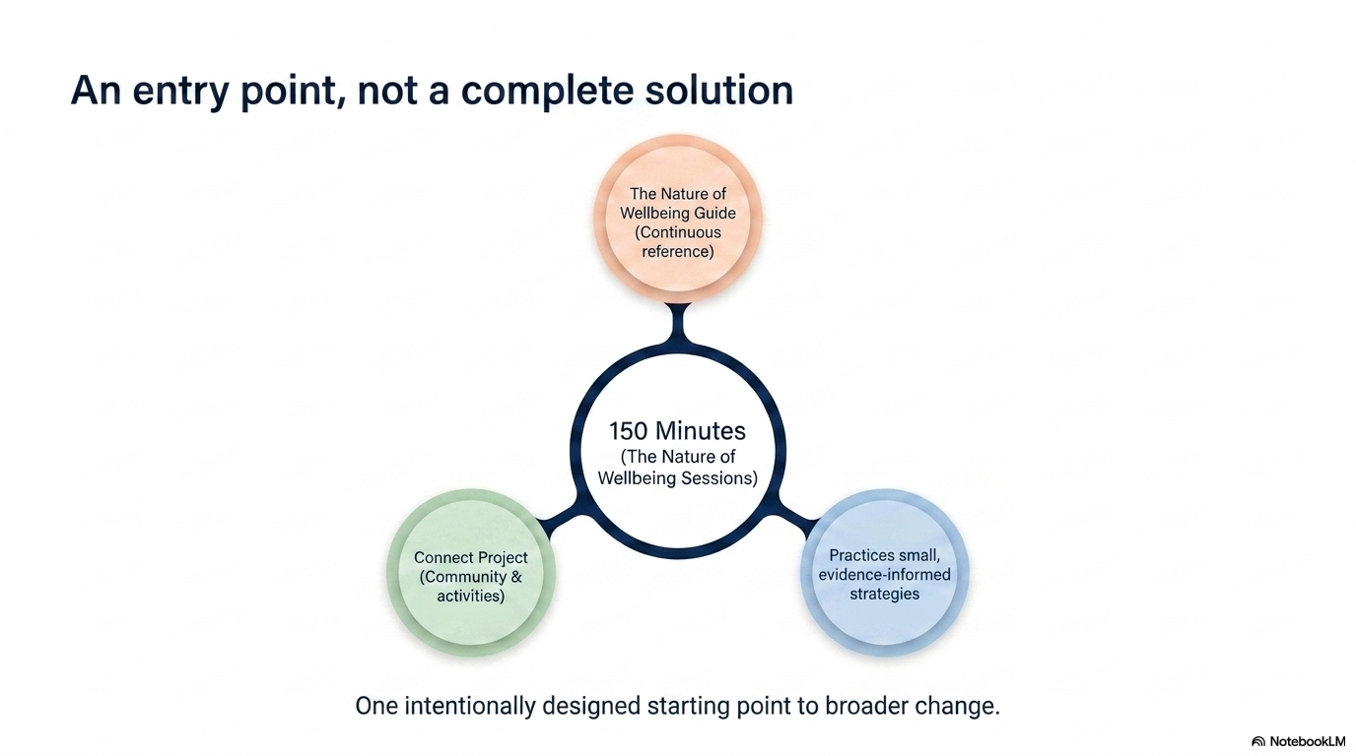

Slide 45
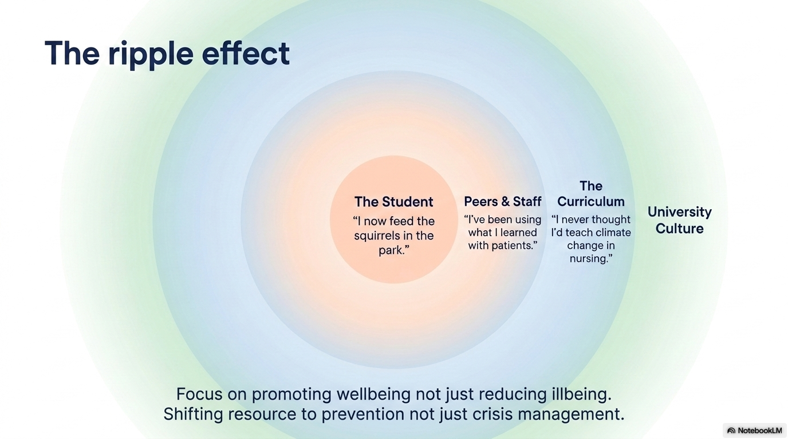

Slide 46
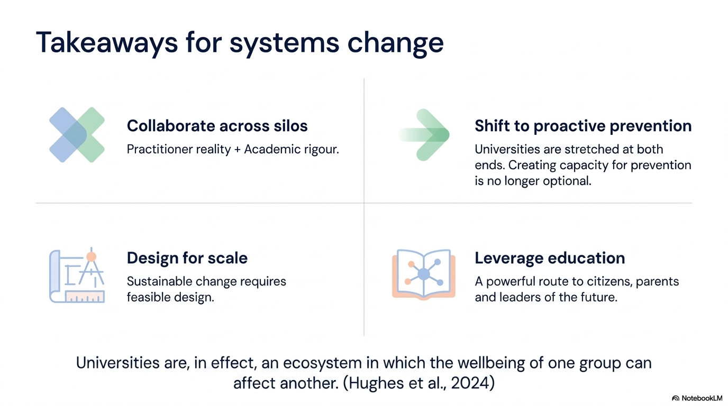

Slide 47
Translating Sustainable Wellbeing into Clinical Practice
How do we translate an integrated model of wellbeing into a practical intervention that helps people build wellbeing?
Context: Community Acquired Brain Injury Service (Neurorehabilitation Service)
Why?
People weren’t simply asking how to manage the consequences of brain injury. They were asking how to rebuild a meaningful life beyond it.
Notes:
As you’ve heard from my colleagues, our work has focused on developing an integrated understanding of sustainable wellbeing.
My part of the symposium asks a slightly different question.
How do we translate that theoretical understanding into something clinicians can actually deliver and people can actually experience?
I’ll explore that question through one context in which we’ve been applying the model, our Community Acquired Brain Injury Service.
We chose this context because acquired brain injury presents profound and often lifelong challenges. Traditional rehabilitation can help people understand and manage many of the consequences of injury, but over years of working alongside people living with brain injury, we found they were asking a different question.
They weren’t simply asking how to manage brain injury.
They were asking how to rebuild a meaningful life beyond it.
And that became the starting point for everything that followed

Slide 48
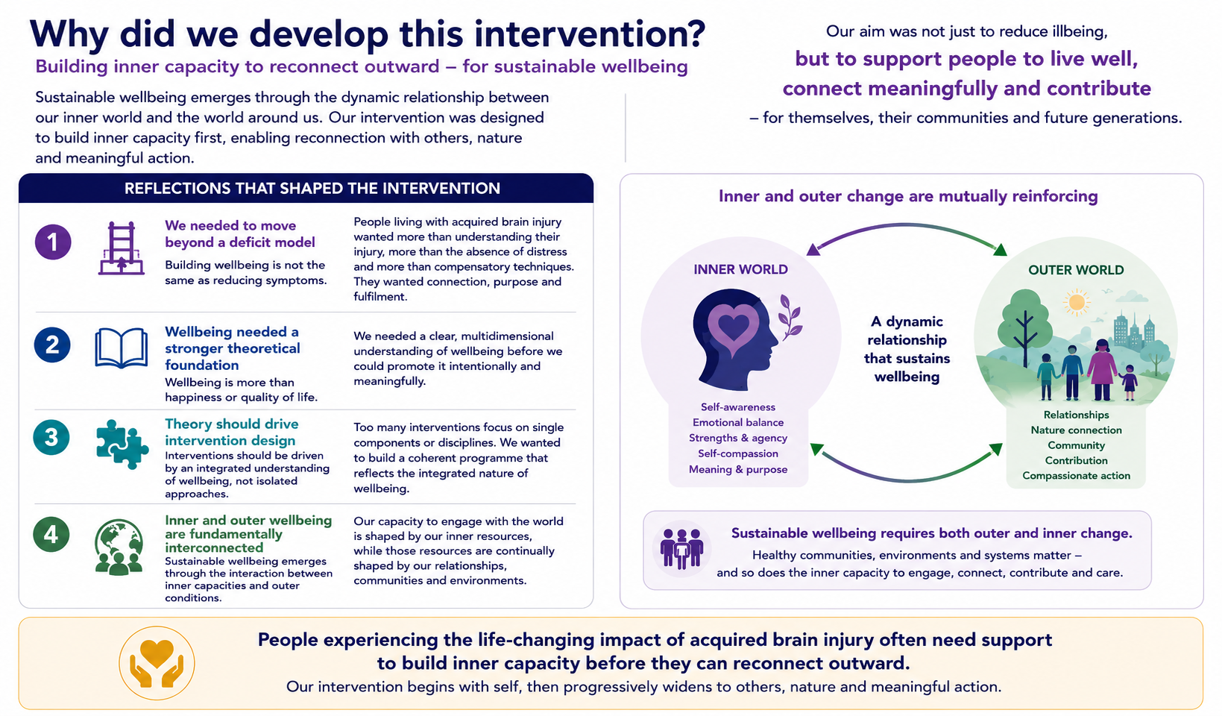

Slide 49


Slide 50

The structure of the intervention

Slide 51


Slide 52

Davies, K., Fisher, Z., & Kemp, A. (2025). Empowering people with acquired brain injury to master their well-being: a thematic analysis of participant experience of an 8-week positive psychotherapy group. International journal of qualitative studies on health and well-being, 20(1), 2595847. https://doi.org/10.1080/17482631.2025.2595847

Slide 53


Slide 54


Slide 55

The Well-being of Future Generations Act and the Sustainable Development Goals rightly emphasise creating healthier, fairer and more sustainable environments.
But people also need the psychological, social and emotional capacity to engage with those opportunities, adapt to change, build relationships and contribute to their communities.
Sustainable wellbeing therefore emerges through the continual interaction between inner capacities AND outer conditions.

Slide 56
Healthy environments create opportunities for people to flourish.
People with the capacity to flourish strengthen their communities.
Stronger communities help create a healthier and more sustainable world.
Sustainable wellbeing begins within people, grows through relationships and communities, and ultimately contributes to healthier societies and a healthier planet.

Slide 57


Selected References
Fisher, Z., Galloghly, E., Boglo, E., Gracey, F., & Kemp, A. H. (2022). Emotion, Wellbeing and the Neurological Disorders. In Encyclopedia of Behavioral Neuroscience (Vol. 2, pp. 220–234). https://doi.org/10.1016/b978-0-12-819641-0.00013-x
Isham, A., Jefferies, L., Blackburn, J., Fisher, Z., & Kemp, A. (2025). Green Healing: Ecotherapy as a Transformative Model of Health and Social Care. Current Opinion in Psychology, 102005. https://doi.org/10.1016/j.copsyc.2025.102005
Kemp, A. H., Mead, J., & Fisher, Z. (2022). Improving Student Wellbeing: Evidence From a Mixed Effects Design and Comparison to Normative Data. Teaching of Psychology, 009862832211124. https://doi.org/10.1177/00986283221112428
Mead, J., Fisher, Z., & Kemp, A. H. (2021). Moving Beyond Disciplinary Silos Towards a Transdisciplinary Model of Wellbeing: An Invited Review. Frontiers in Psychology, Frontiers in Psychology, 12, 642093. https://doi.org/10.3389/fpsyg.2021.642093
Wilkie, L., Fisher, Z., Geidel, A., Goodall, I., Kamil, S., Davies, E., & Kemp, A. H. (2026). A systematic review and network meta-analysis of randomized controlled trials of well-being-focused interventions. Nature Human Behaviour. https://doi.org/10.1038/s41562-025-02369-1
Scan me to access publications →

